Slide 1
Matrix Basic Operations
Mostafa Saad Ibrahim
Teaching Assistant @ Cairo University

Slide 2

For Easy Code

Slide 3

Zero Matrix
Matrix with all values are zero
0 | 0 | 0 | 0
0 | 0 | 0 | 0
0 | 0 | 0 | 0

Slide 4
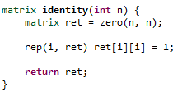
Identity Matrix
Matrix with diagonal values are one
1 | 0 | 0
0 | 1 | 0
0 | 0 | 1

Slide 5
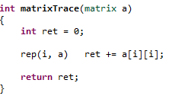
Matrix Trace
Sum of diagonal values.
10 | 1 | 2
-5 | 20 | 7
0 | 0 | 30
Trace = 10+20+30 = 60

Slide 6
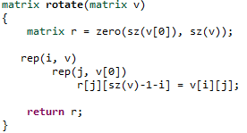
Matrix Clockwise Rotation
0 | 1
9 | 7
4 | 4
1 | 7 | 4
0 | 9 | 4

Slide 7
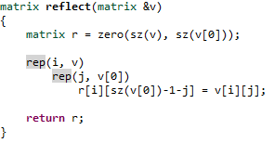
Matrix Reflection
1 | 7 | 4
0 | 9 | 4
4 | 7 | 1
4 | 9 | 0

Slide 8
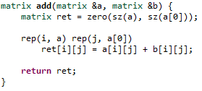
Matrix Addition
Same dimensions for the 2 matrices.
Sum is for corresponding cells
1 | 2 | 3
4 | 0 | 0
1 | 5 | 3
0 | 7 | 9
2 | 7 | 6
4 | 7 | 9
+
=

Slide 9
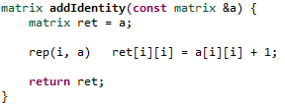
Matrix + 1
Nice utility to add identity to square matrix
7 | 2
4 | 5
1 | 0
0 | 1
2 | 7
4 | 7
+
=

Slide 10
Matrix Multiplication
Shared column must be equal
(AxB) * (BxC)
B is shared column
Result is AxC Matrix
(i, j) cell = ith row x jth column.
Both of them are B length
Order is O(N^3)…there is another algorithm more efficient

Slide 11
Matrix Multiplication
1 | 2
3 | 4
5 | 6
1 | 2 | 3 | 4
5 | 6 | 7 | 8
*
=
Cell (2, 3)
2nd row in A = (3, 4)
3rd column in B = (3, 7)
Row x Col = 3*3 + 4*7
= 37
11 | 14 | 17 | 20
23 | 30 | 37 | 44
35 | 46 | 57 | 68
(3x2) * (2x4) = 3x4

Slide 12
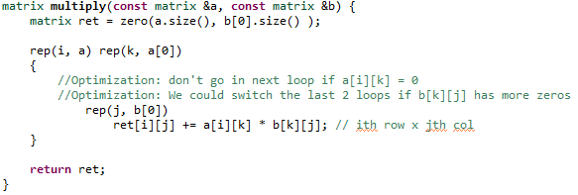
Matrix Multiplication

Slide 13
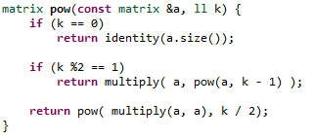
Matrix Power
Similar to normal numbers:
10^8 = (10^2)^4 = (10^4)^2
10^9 = 10 * 10^8

Slide 14
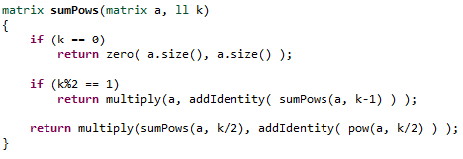
Matrix Powers Sum
(a^1+a^2+a^3+a^4+a^5+a^6) = (a^1+a^2+a^3)+(a^1*a^3+a^2*a^3+a^3*a^3)
(a^1+a^2+a^3)+a^3*(a^1+a^2+a^3) = (a^1+a^2+a^3)*(I+a^3).
(a^1+a^2+a^3+a^4+a^5+a^6+a^7) = a + a*(a^1+a^2+a^3+a^4+a^5+a^6)
= a (1 + a^1+a^2+a^3+a^4+a^5+a^6)

